Slide 1
Millennials and Savings
An Examination of Millennial Responses in the U.S. Financial Health Pulse Survey

Slide 2
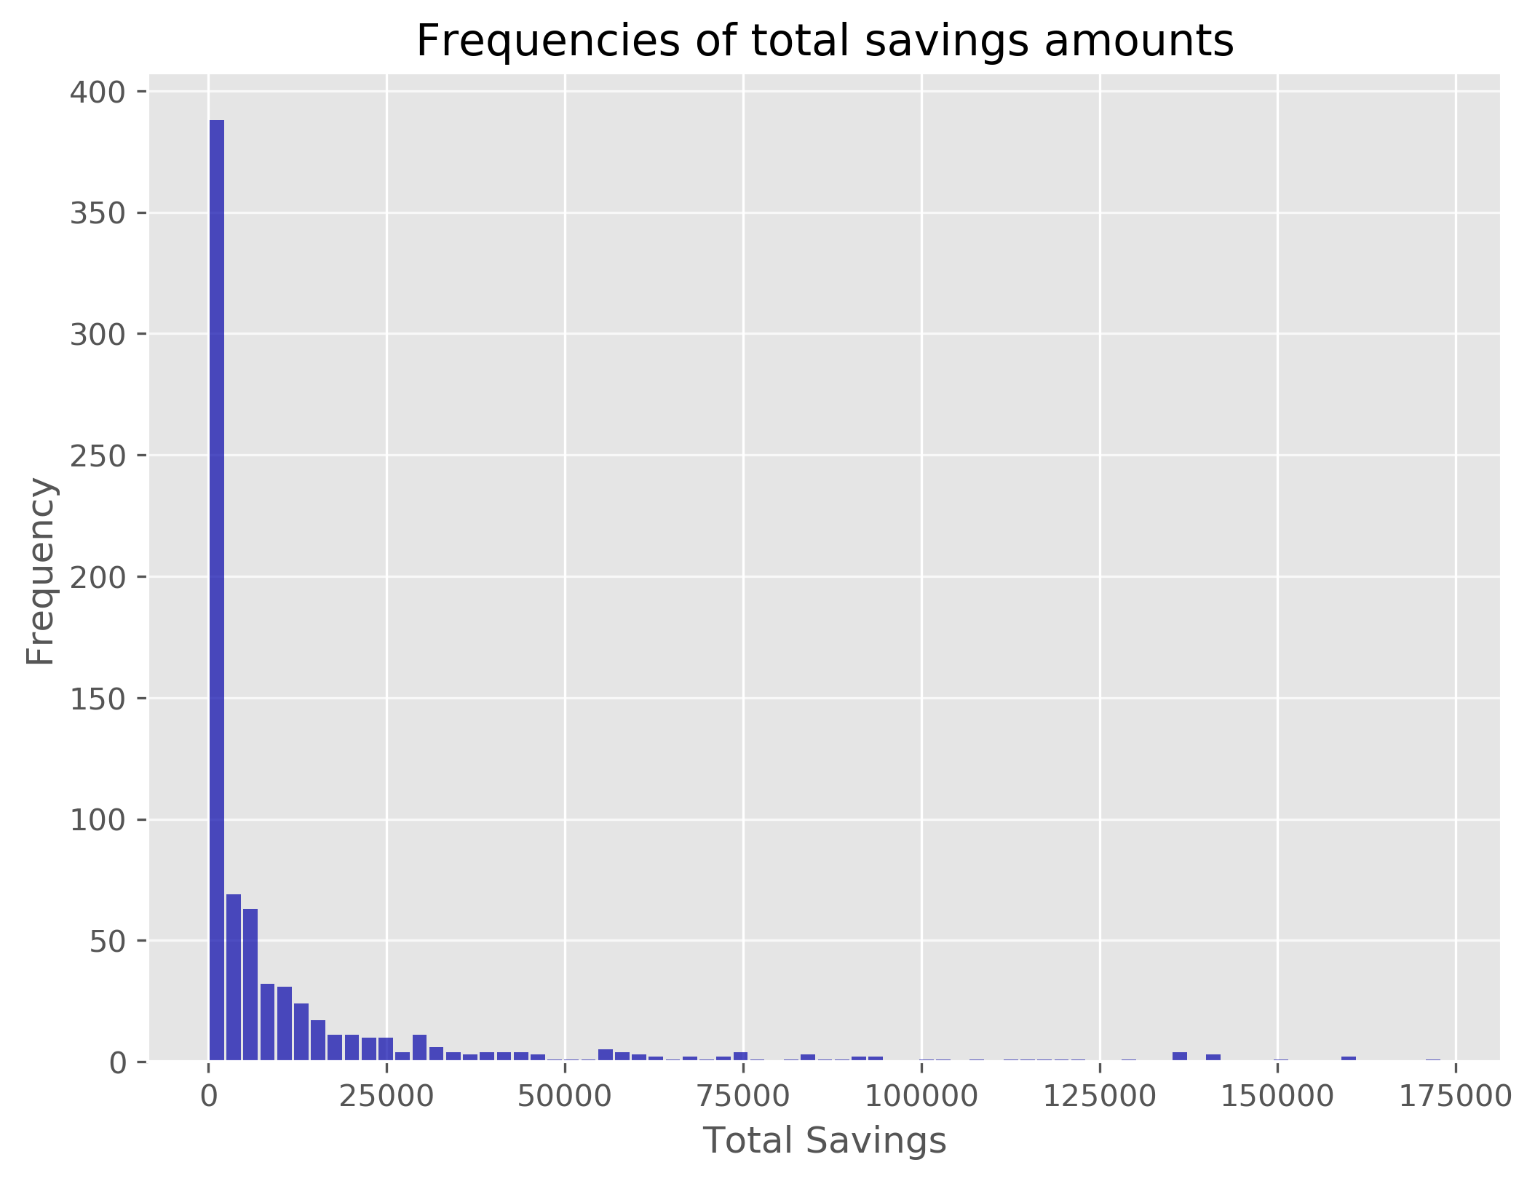
75.7% are currently employed Median income of around $50k to $60k Median savings of around $2,200 Mode is $0
Millennial Trends: Background
58.1% have employer-provided retirement accounts, and 75.3% report saving regularly into this account
23.3% have individual retirement accounts, and 54.4% report saving regularly into this account
30.9% report not having a retirement account
92.8% said they have never tried to calculate how much they need to be saving for retirement

Slide 3
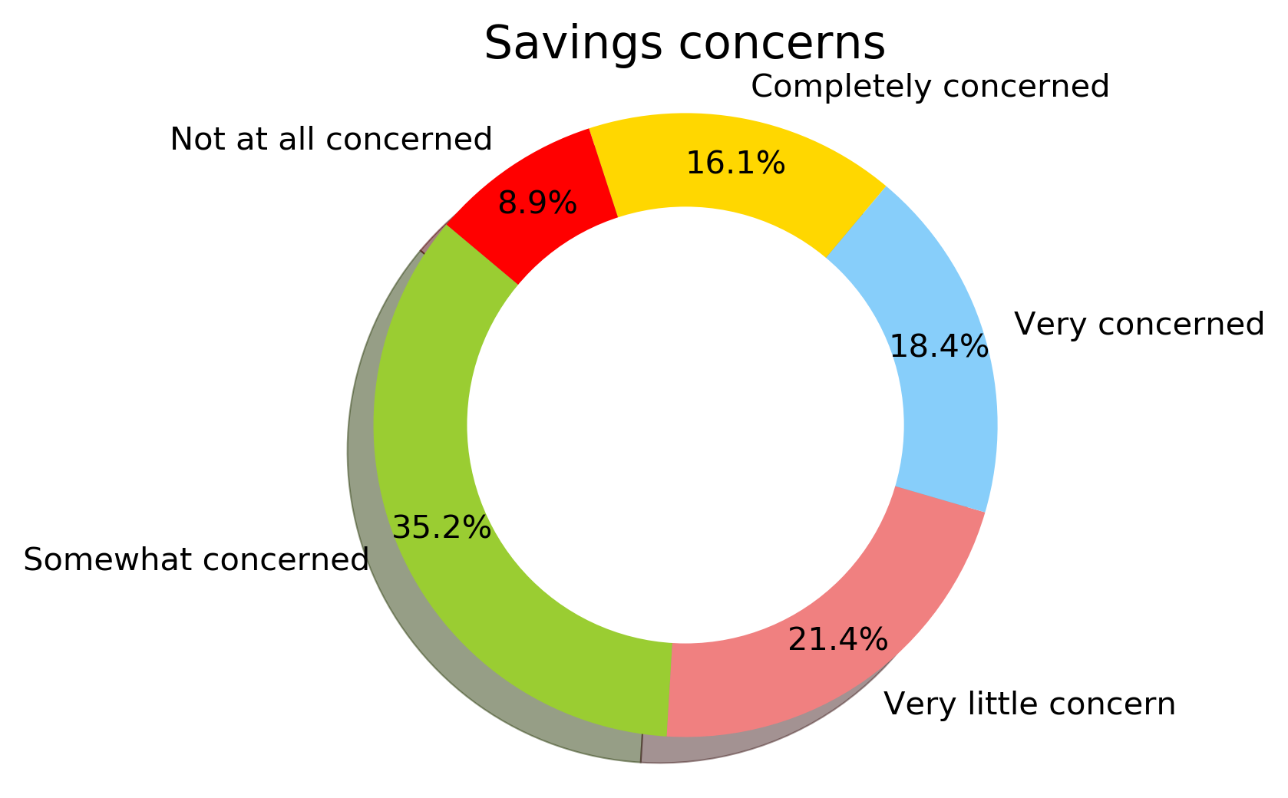
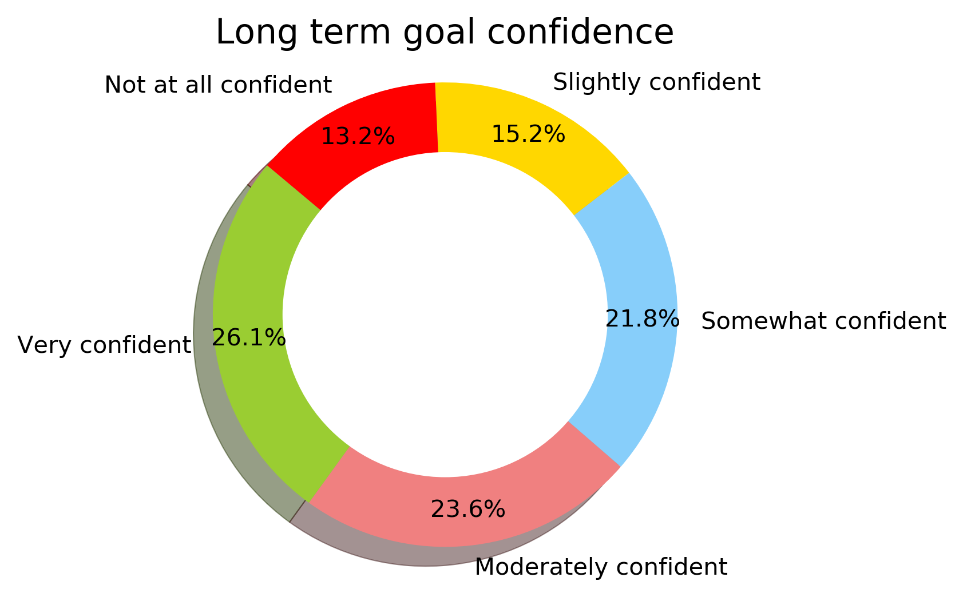
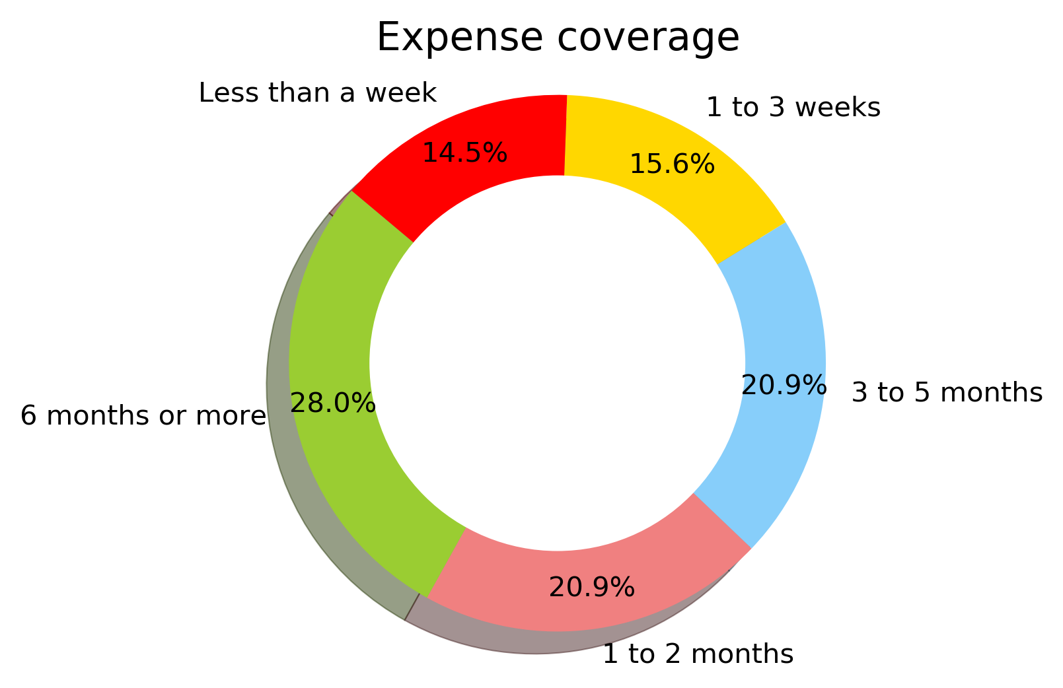
Checking: 18.8% save regularly in checking accounts. 56.6% saved when they could, and 43.5% weren’t currently saving in checking accounts. Savings: 40.3% save regularly in a savings account. 46.0% saved when possible, and 13.7 weren’t currently saving in a savings account. Cash: 15.4% saved in cash regularly, 58.2% saved when in cash when they could, and 26.4% were not saving in cash. Only 24.8% reported having personal savings/investments such as stocks or mutual funds . Of these people, only 41.5% reported regularly saving money into this category. In contrast, 39.5% report having a household emergency fund
Millennial Trends: A Closer Look at Savings
*
*
*
*
*
69.7%
50.2%
51.0%
*
*
*
*

Slide 4
Other considerations
There was a significant difference in liquid savings, with Latinx and Black millennials reporting lower totals than White millennials
People with a bachelor’s degree had more liquid savings than those without*, but they did not have more liquid savings than those with a masters or above.
*However, are people with more liquid savings more easily able to obtain a bachelors?
Concerns about expense coverage, achieving long term goals, and savings concerns were lower amongst millennials who reported higher levels of liquid savings

Slide 5
Mixed savings messages, and what this says Savings related concerns ‘Zero liquid savings’ Having savings is protective against concerns 56.6% & 46.0 %saving when possible (checking & savings) Household emergency funds
Savings vs. savings: from the millennial end
Lack of understanding of what savings are, or how to approach it
Savings vs. savings: addressing millennial concerns
Making financial well-being approachable
Micro-saving
Realistic goal setting
Micro-investing
Conversations about retirement
Notes:
Anxiety about savings lasting, how long someone could live off savings if they had to, and that they’re successfully savings towards a long term goal (at or above 50%.

